Slide 1
Biomedical Engineering
Urs Utzinger
2018, 2019 Summer Engineering Academy
University of Arizona , College of Engineering

Slide 2
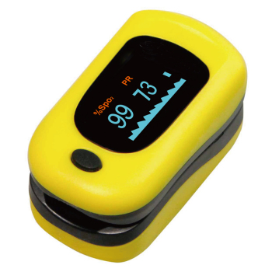
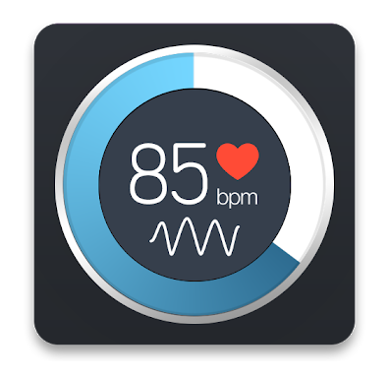
Demo
Instant Heart Rate
Mobile App - free
Walgreens - $45

Slide 3
Medical Relevance
How do we adjust to an increase in fuel and oxygen demand?

Slide 4
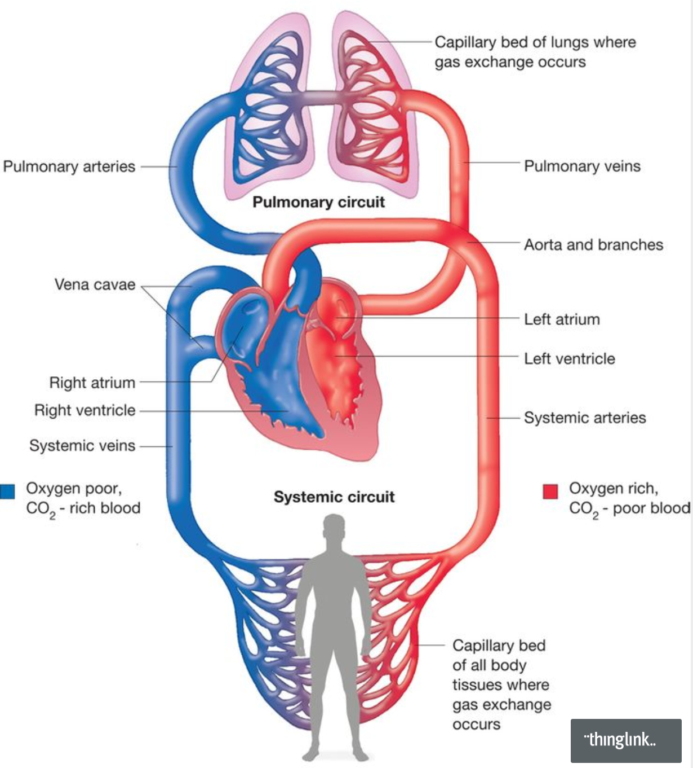
https://www.thinglink.com/scene/792075535718023169
Motor: RPM
Heart: BPM

Slide 5
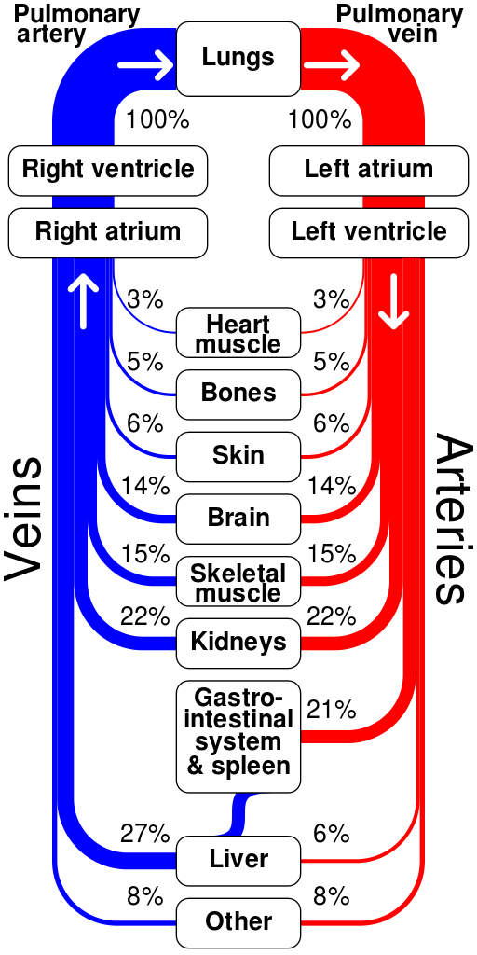
Where does the Supply go?
Notes:
We will have quite a bit of flow to the skin

Slide 6
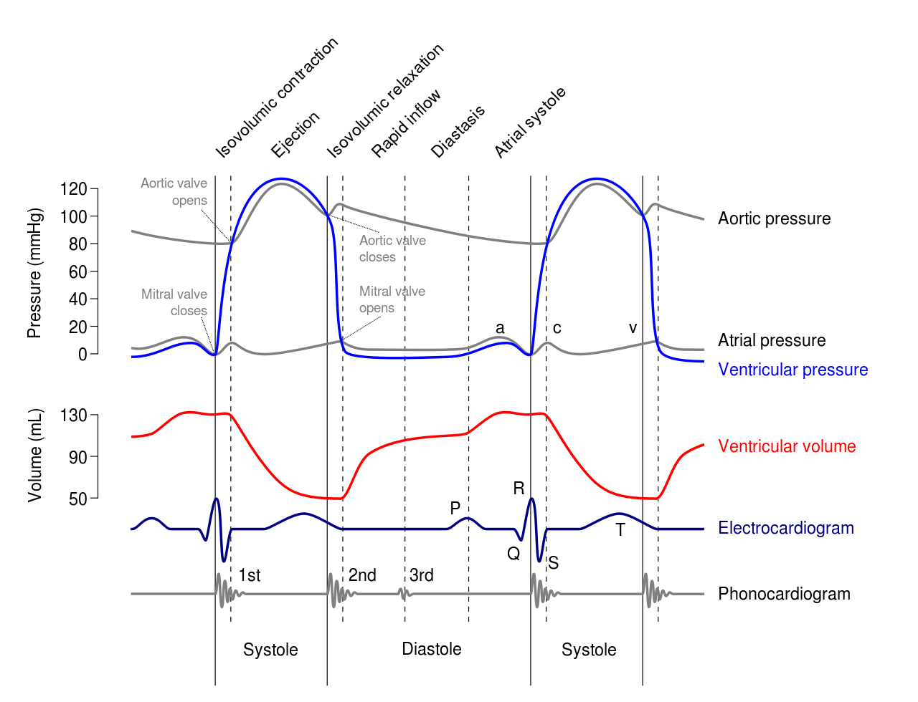
What Signals can you measure?
Notes:
Wigger’s Diagram: Pressure, Volume, Electric, Sound

Slide 7

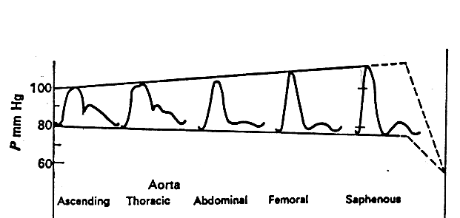
Photoplethysmography: PPG
Pressure in Arterial Tree
Notes:
https://en.wikipedia.org/wiki/Photoplethysmogram

Slide 8
How does PPG work?

Slide 9
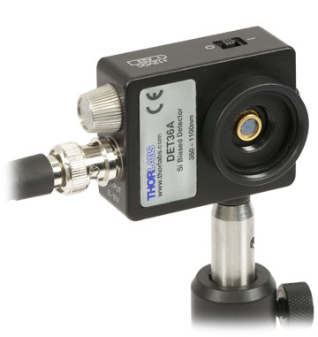


Photo Plethysmo Gram
Light
Detector
Light
Source
Light
Detector
Light
Source
Transmission
Reflection

Slide 10
Notes:
How does signal look like?

Slide 12
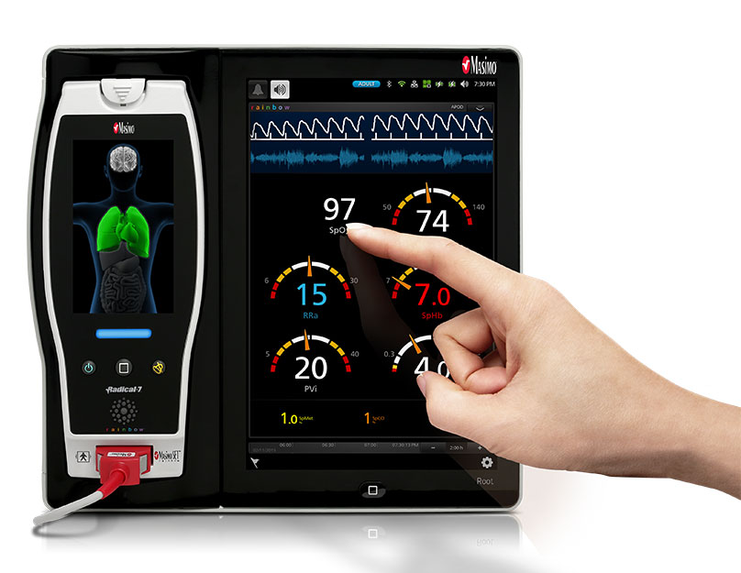
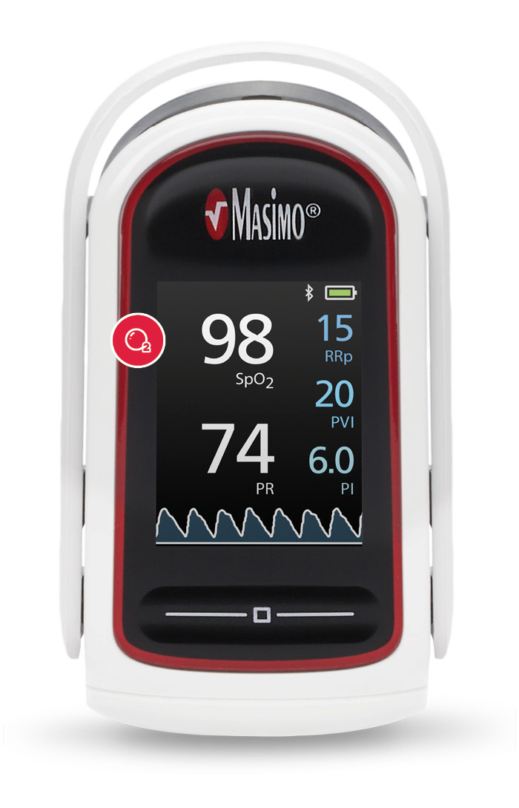
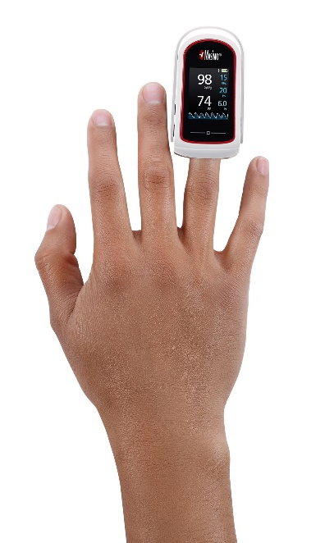
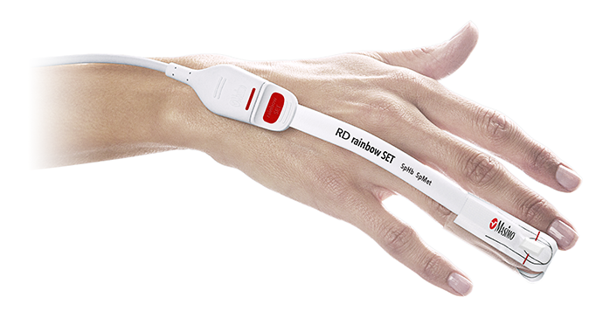
2018: $2600 + $20
2018: $300
Notes:
Top of Line Masimo Product.
Finger sensor hooks to phone via bloottooth
It measures respiration, perfusion in addition to oxygenation and heartrate
RRp respirator rate
PVI perfusion variability index
PI perfusion index

Slide 13
How is the Amount of Oxygen in the Blood measured?

Slide 14
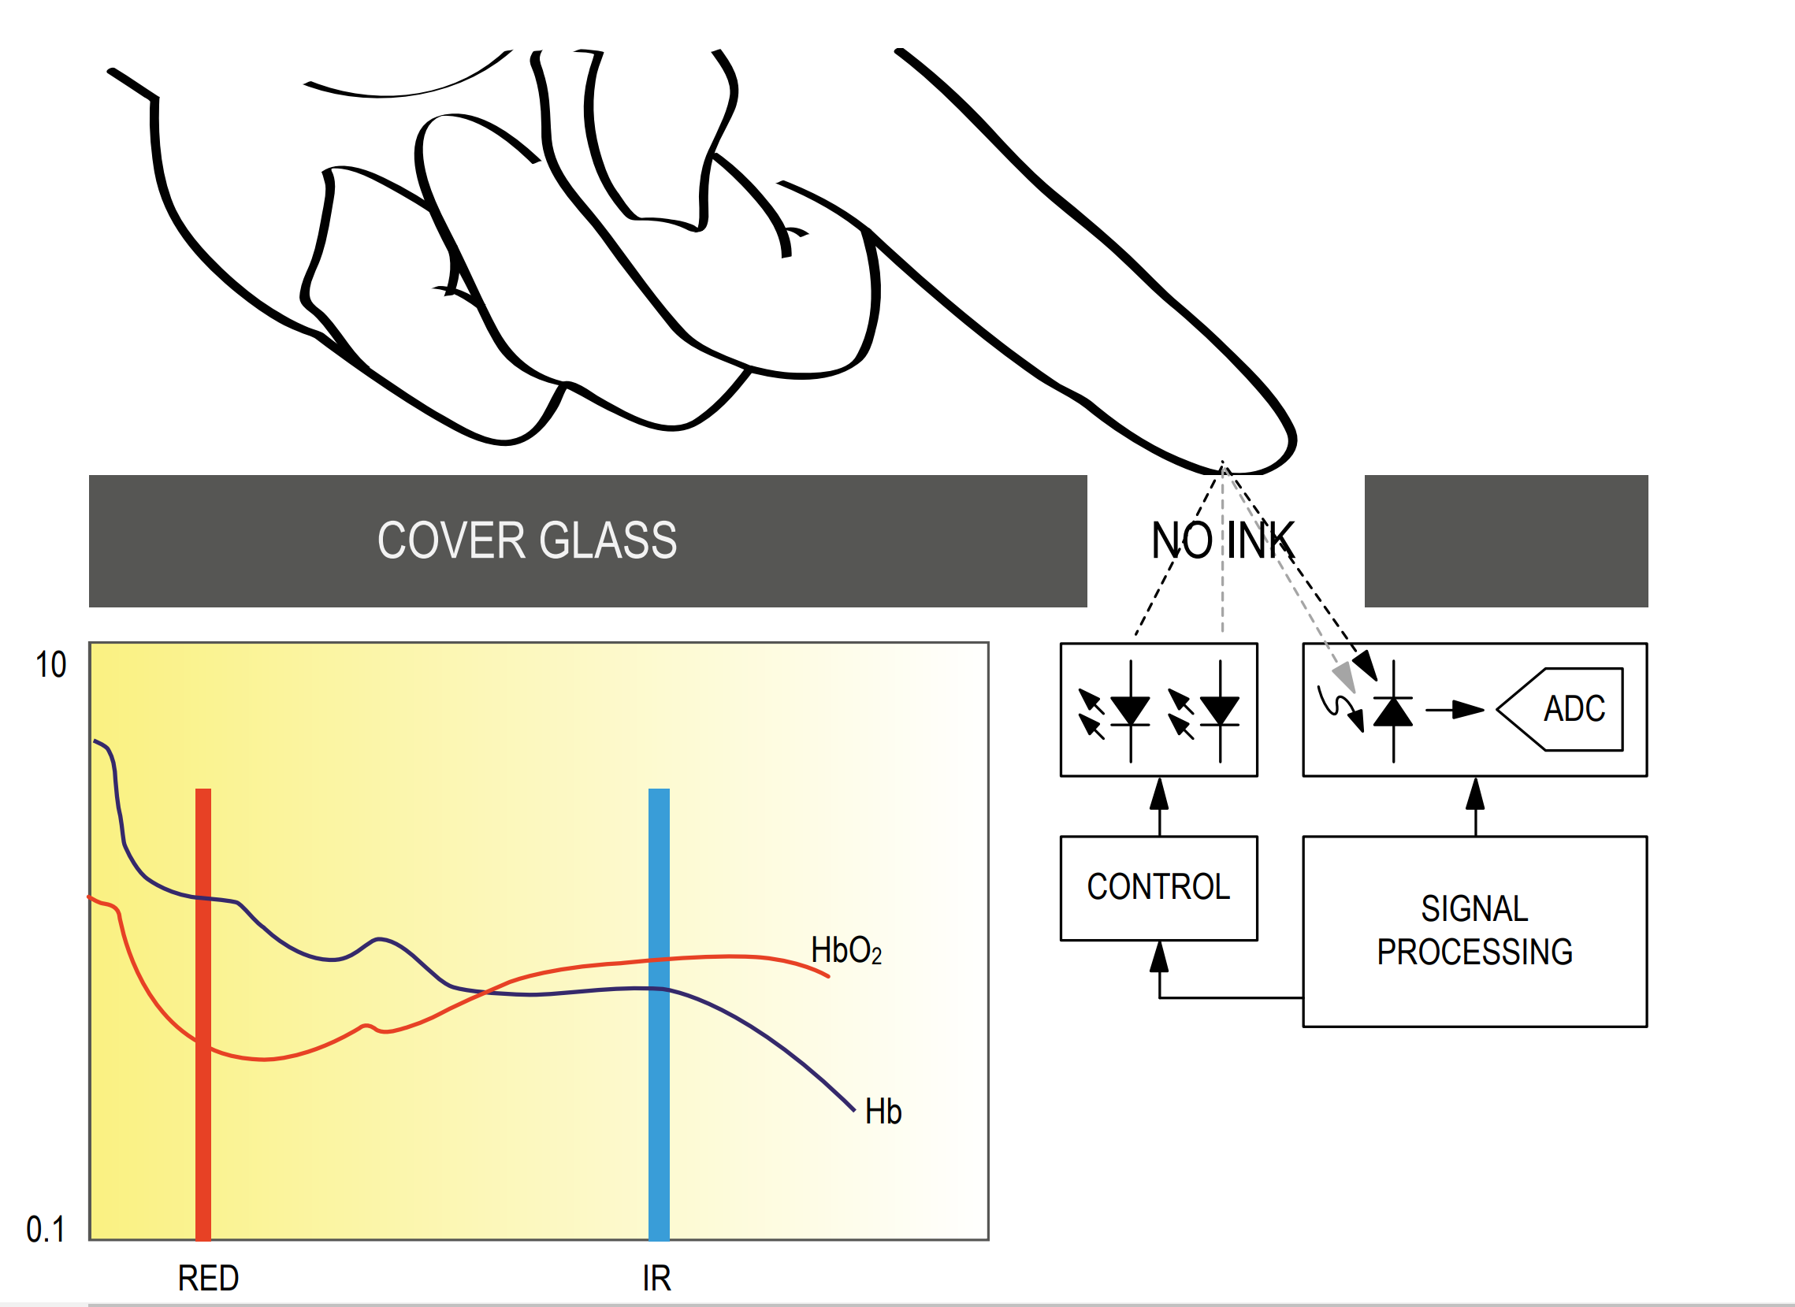

Slide 15
Mobile Health Sensor
Smart Phone has a
Light Sensor (light intensity, to adjust display intensity)
Proximity Sensor (light intensity)
Activity Sensor (accelerometer: falling down, in pocket, portrait)
Smart Watch has
Heart Beat Sensor (green light)
Blood Oxygenation Sensor (red and near infrared light)
Notes:
Fully integrated sensor

Slide 16
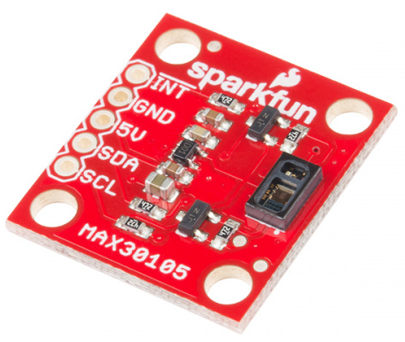
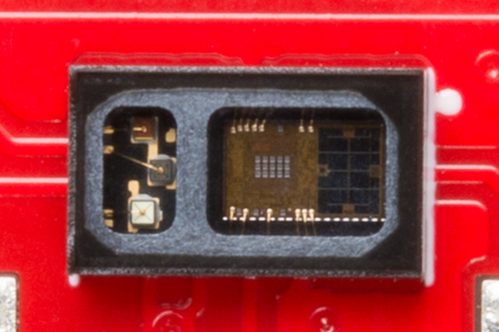
Maxim: MAX30105
2019:
US: $14
Banggood: $1.48
2019:
US: $4.75 @ digikey

Slide 17
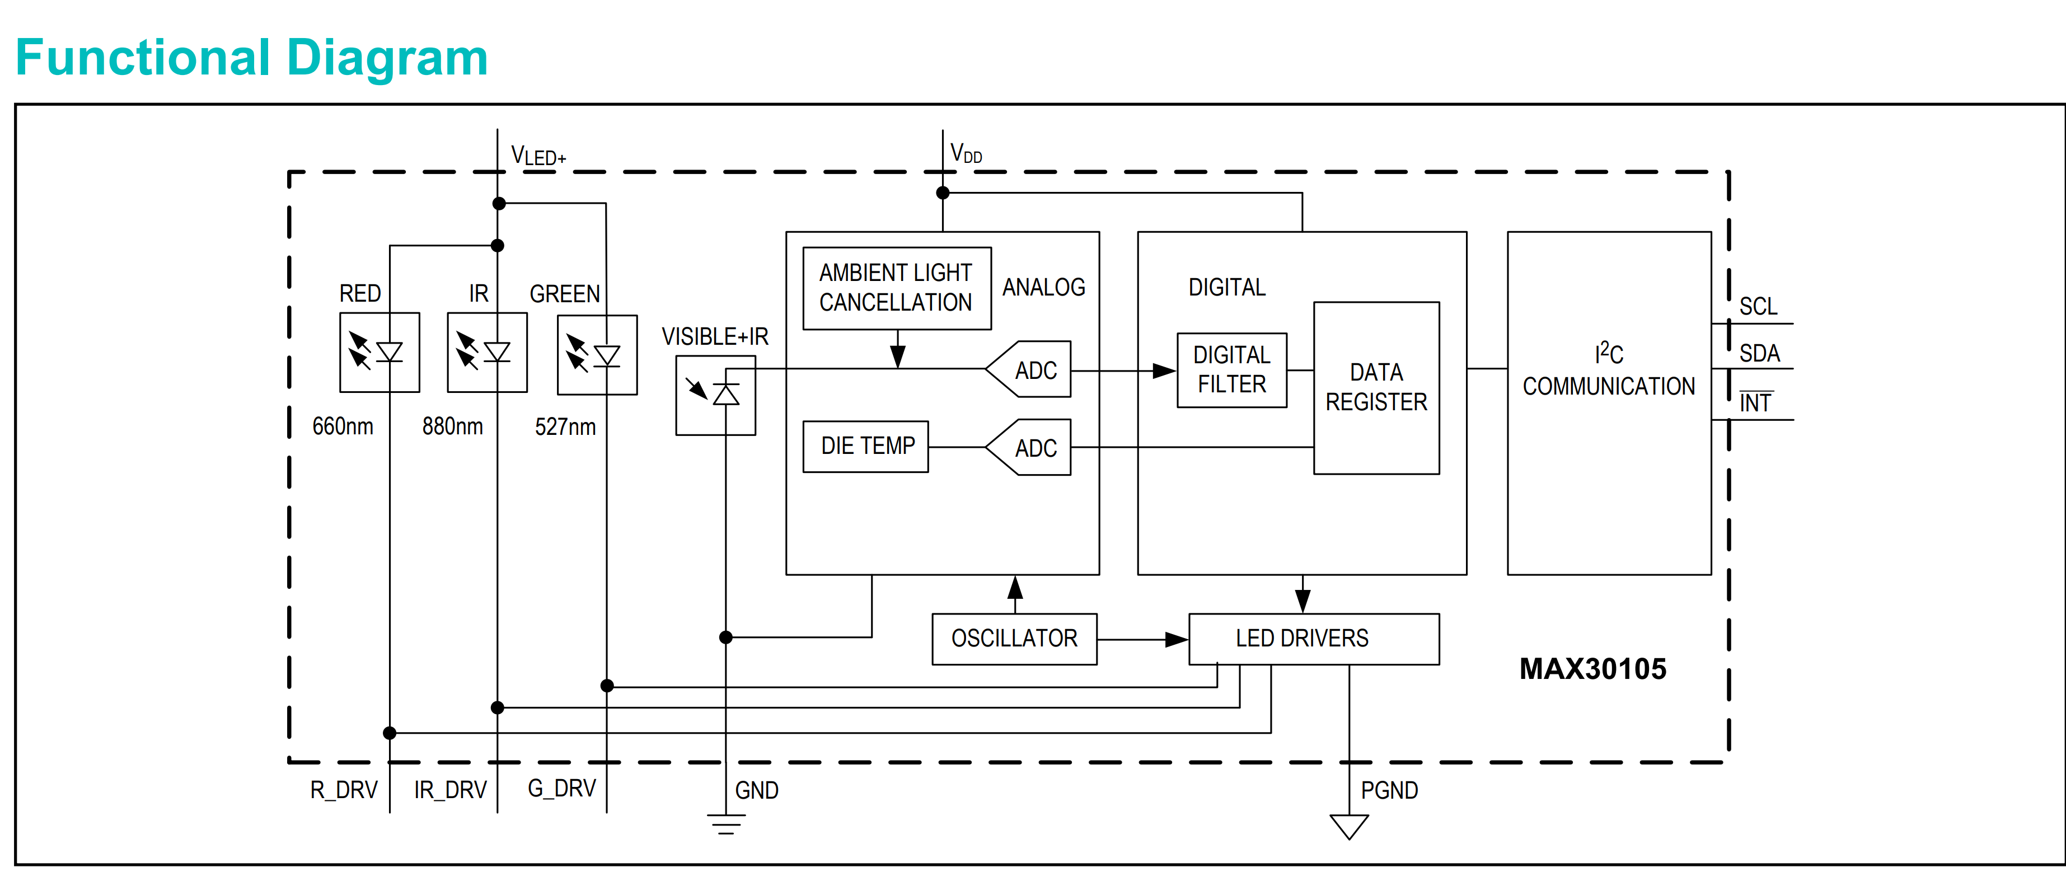

Slide 18
Lets build our own

Slide 19
Materials & Tools
MATERIALS
ESP8266 [$3.90]
Pulse Sensor MAX30100 [$4.65]
Jumper Wire (4) [$0.16]
Solderless Protoboard [$1.50]
Micro USB Cable [$0.75]
Total: [$12 ,1-2 months for delivery of parts from China]

Slide 20
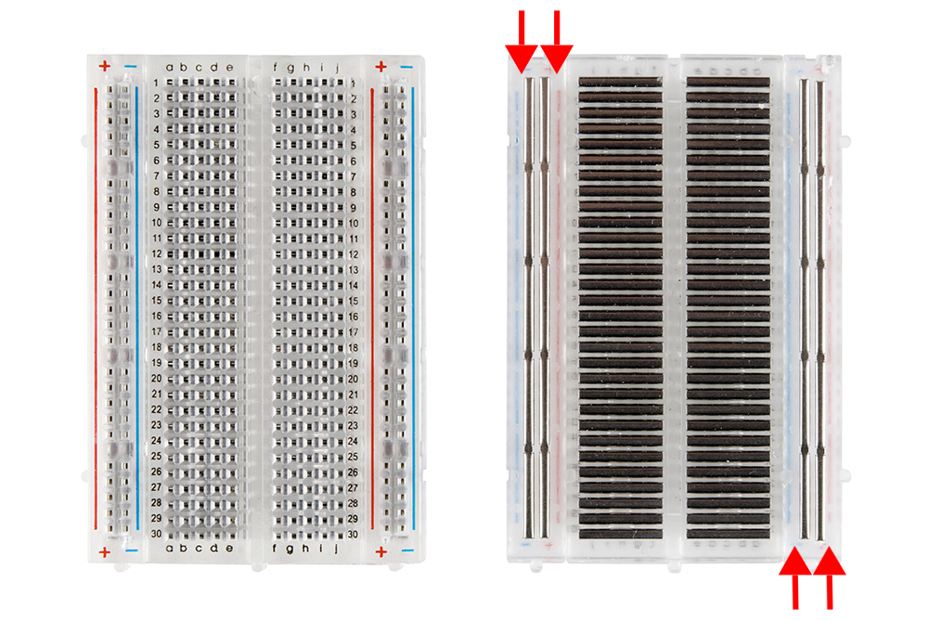

Slide 21
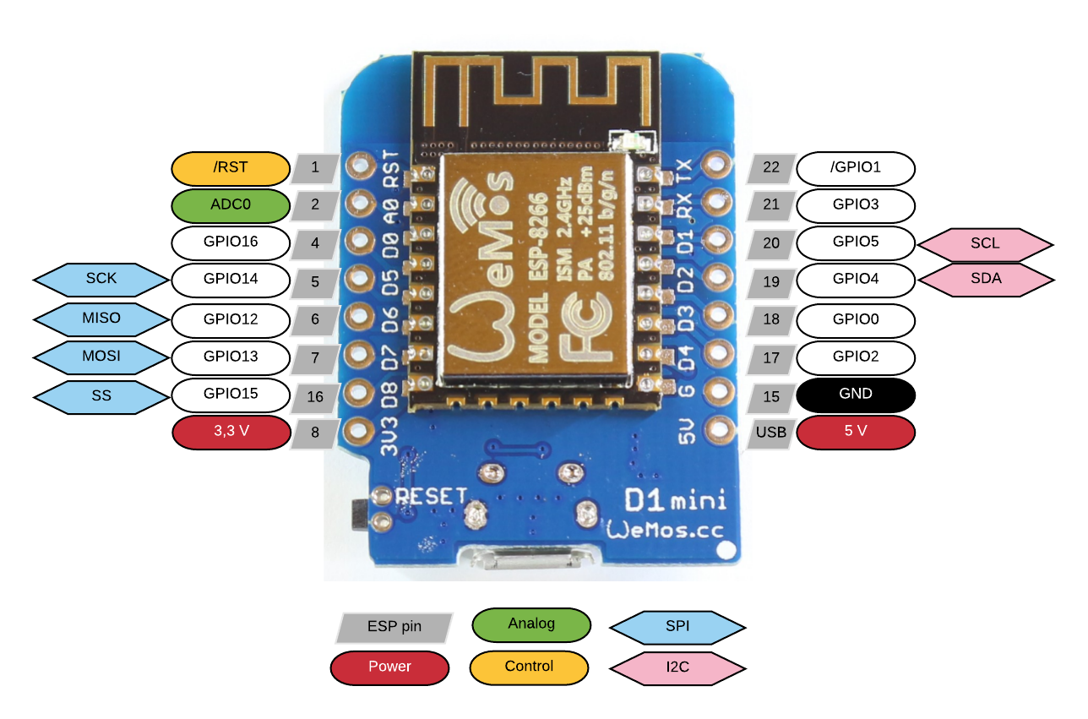
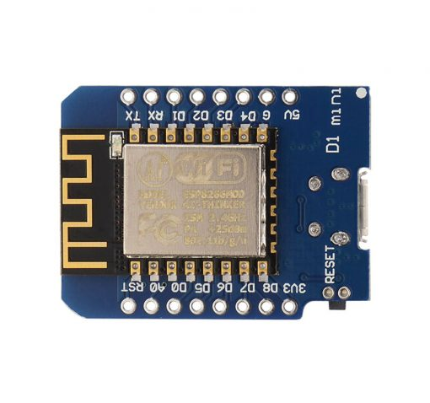
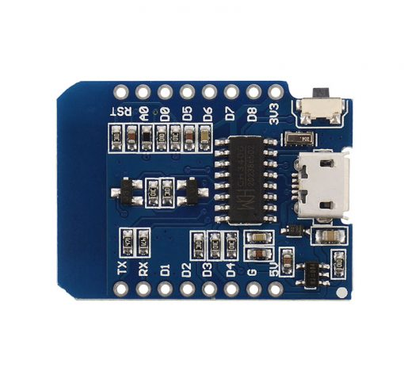
ESP8266 Wemos D1 Mini

Slide 22
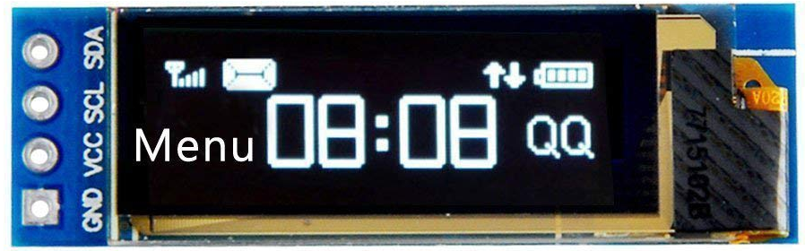
128x32 OLED Display

Slide 23
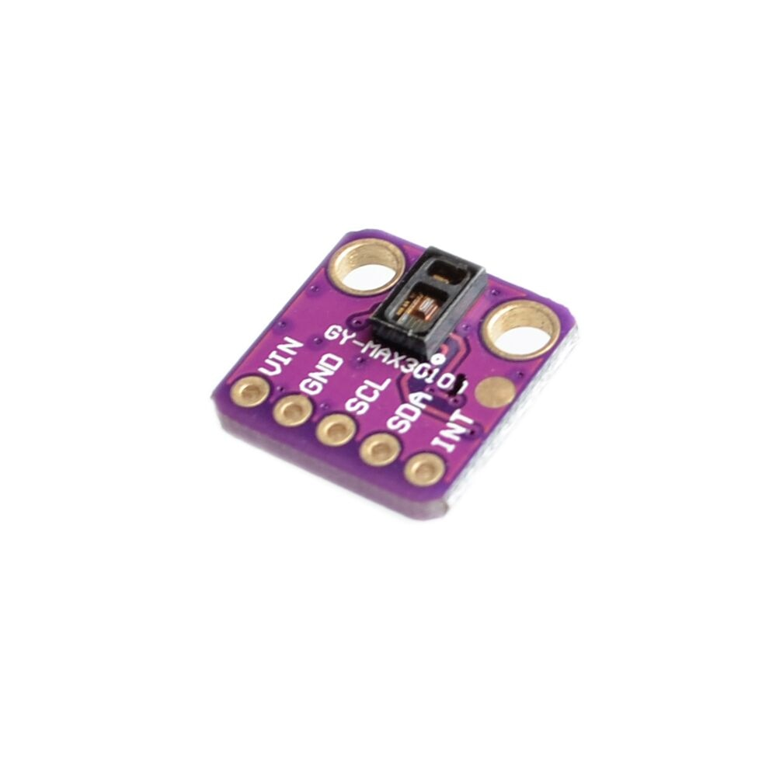
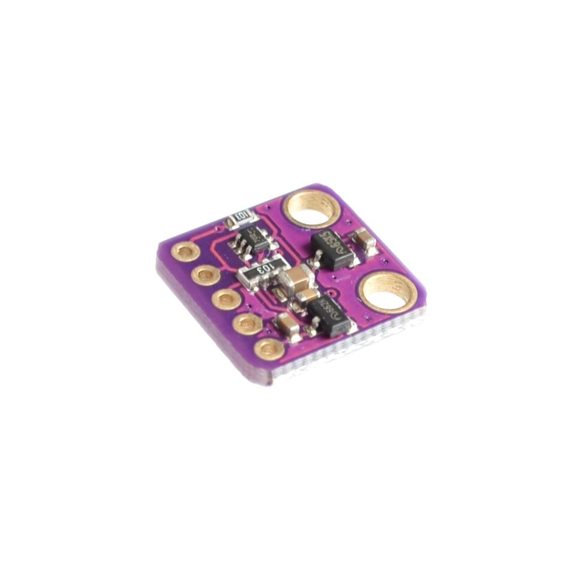
MAX 30100 Pulse Oximeter Sensor

Slide 24
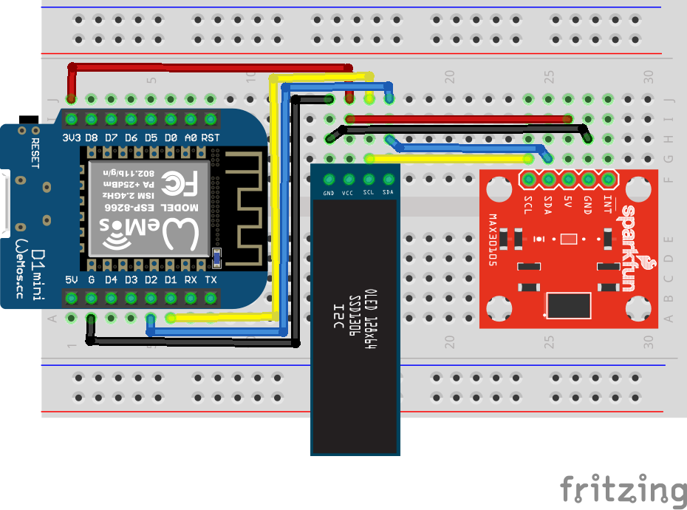
Circuit Wiring
Make these connections.
Do NOT power up!!
D1 ESP Microcontroller | OLED 128x32 Display | MAX3010x Sensor
3.3V | VCC | Vin
G | GND | GND
D1 | SCL | SCL
D2 | SDA | SDA

Slide 25
Please have your circuit checked by a mentor/counselor before you continue

Slide 26
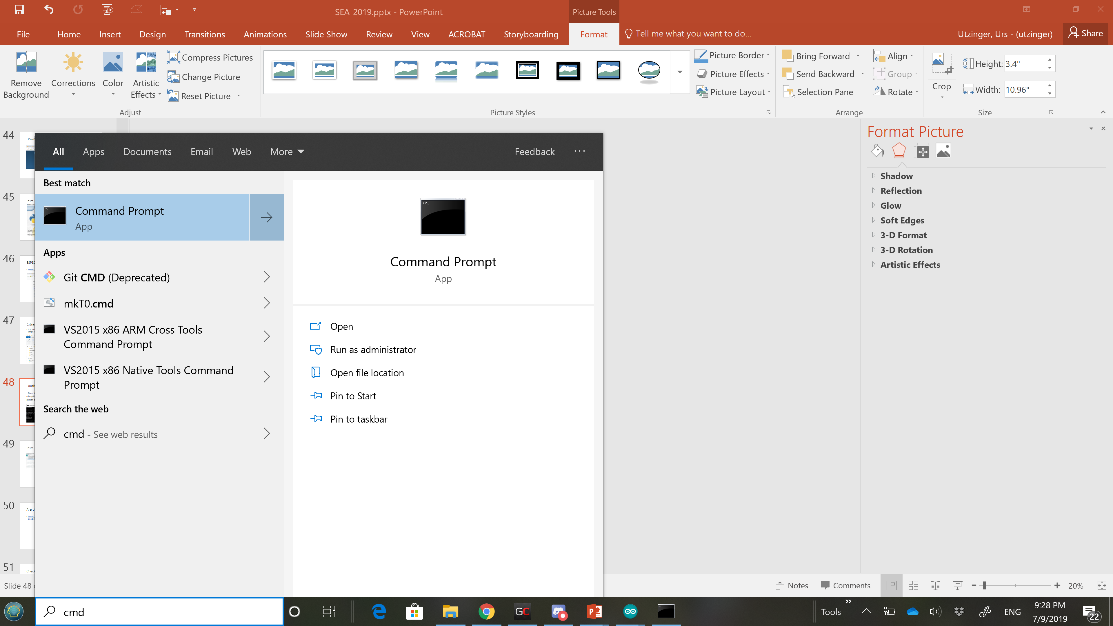
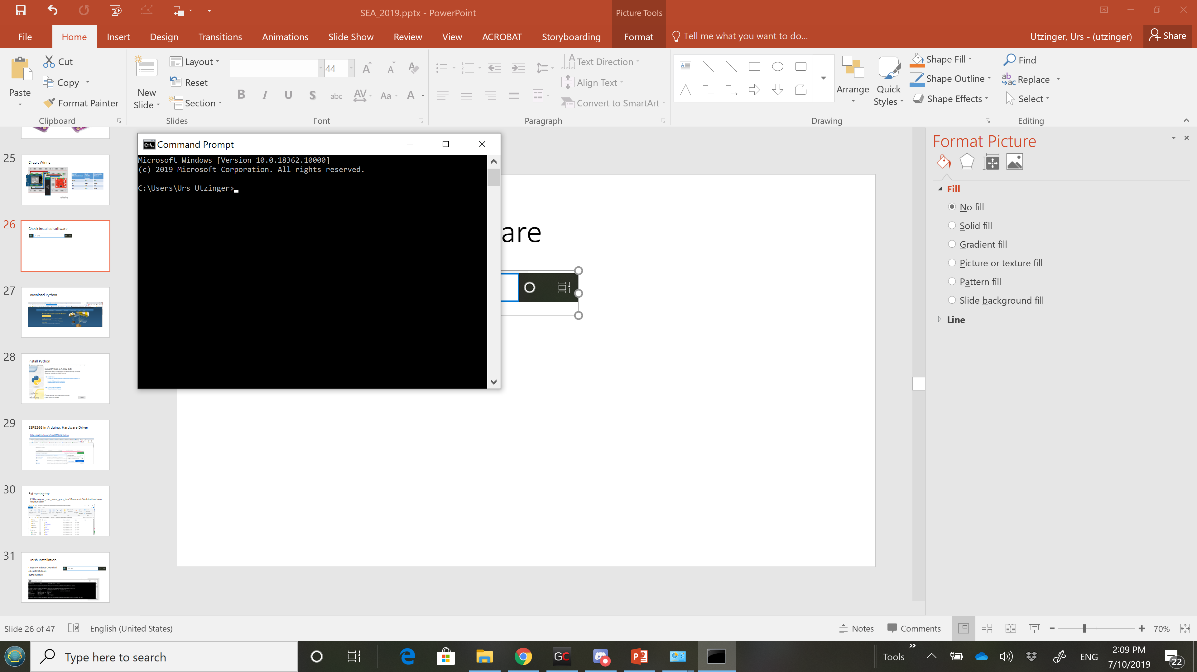
Check installed software
Type in the command window
Python
Git

Slide 27
If you don’t have python

Slide 28
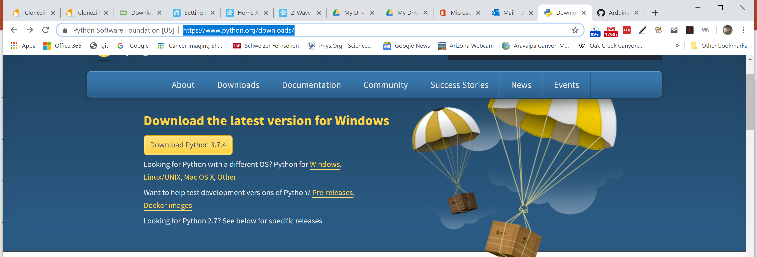
If you don’t have Python: Download it

Slide 29
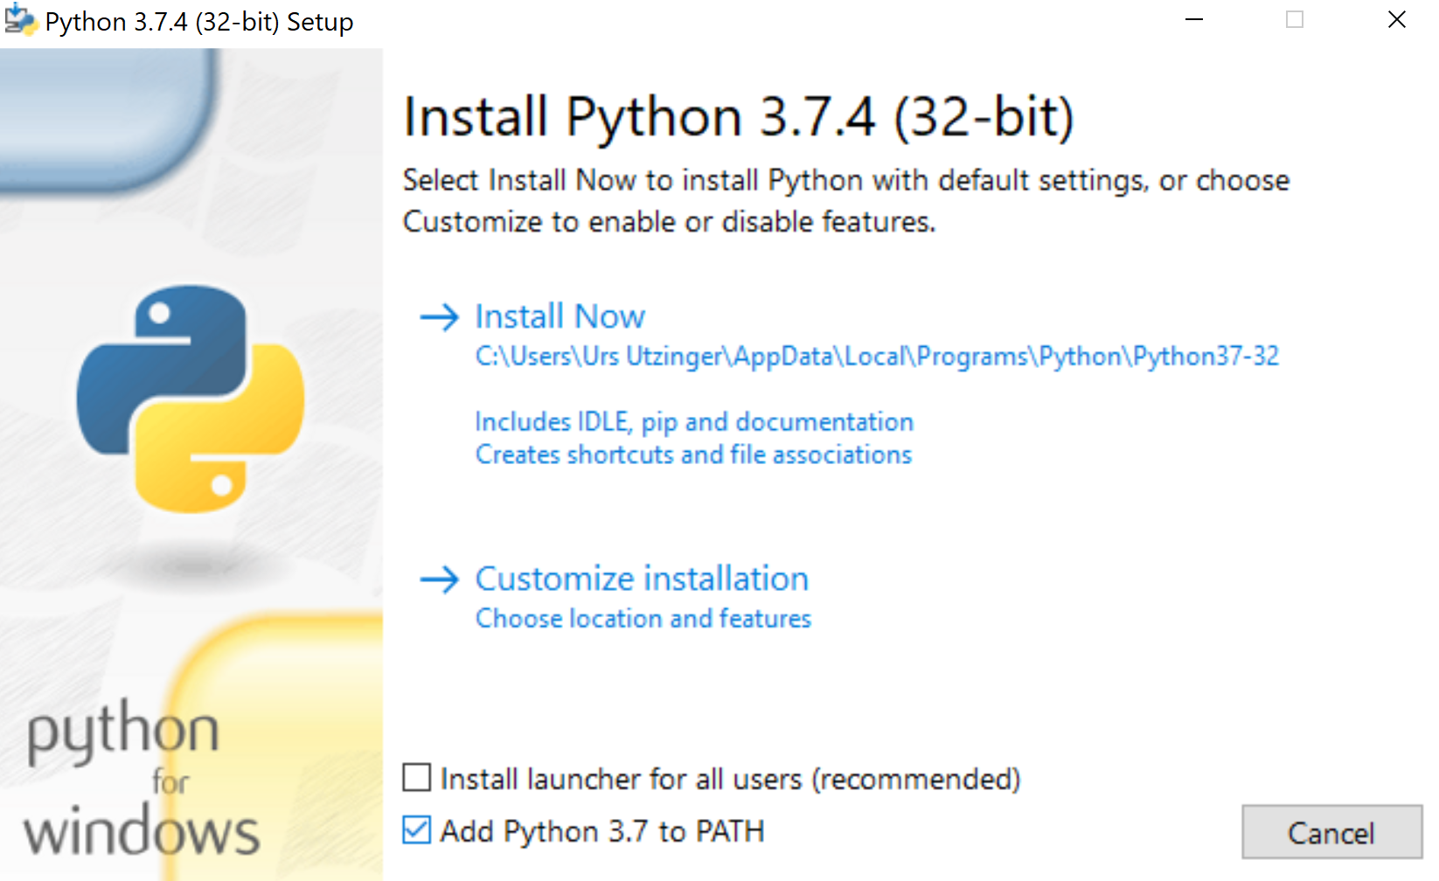
Install Python

Slide 30
If you don’t have git

Slide 31
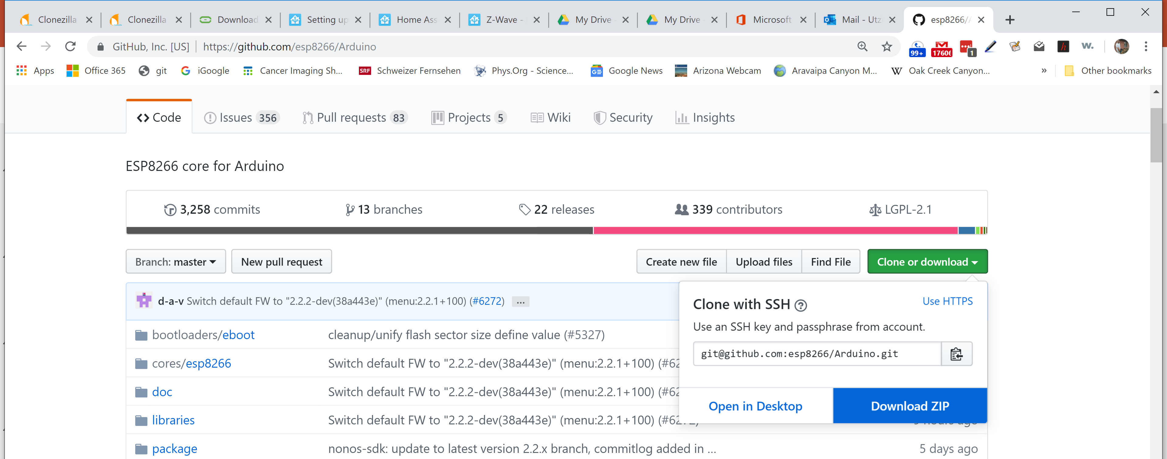
ESP8266 in Arduino: Hardware Driver
If you don’t have git:
Download the Hardware Driver as zip
Otherwise follow instruction for git in readme file
https://github.com/esp8266/Arduino

Slide 32
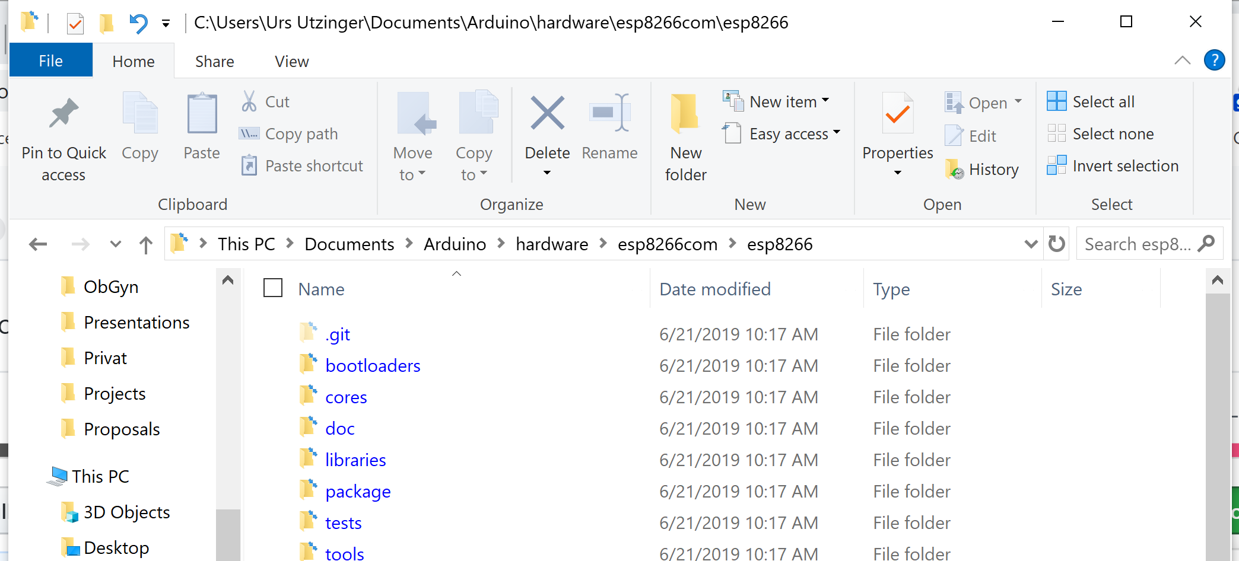
If you don’t have git: Extracting to:
C:\Users\your_user_name_goes_here\Documents\Arduino\hardware\esp8266com

Slide 33
If you have git

Slide 34
Execute text within “ “
“cd C:/users/your username/Documents/Arduino”
“ls” for list
If hardware does not exist “mkdir hardware”
“cd hardware”
“mkdir esp8266com”
“cd esp8266com”
“git clone https://github.com/esp8266/Arduino.git esp8266”
“cd esp8266”
“git submodule update –init”

Slide 35
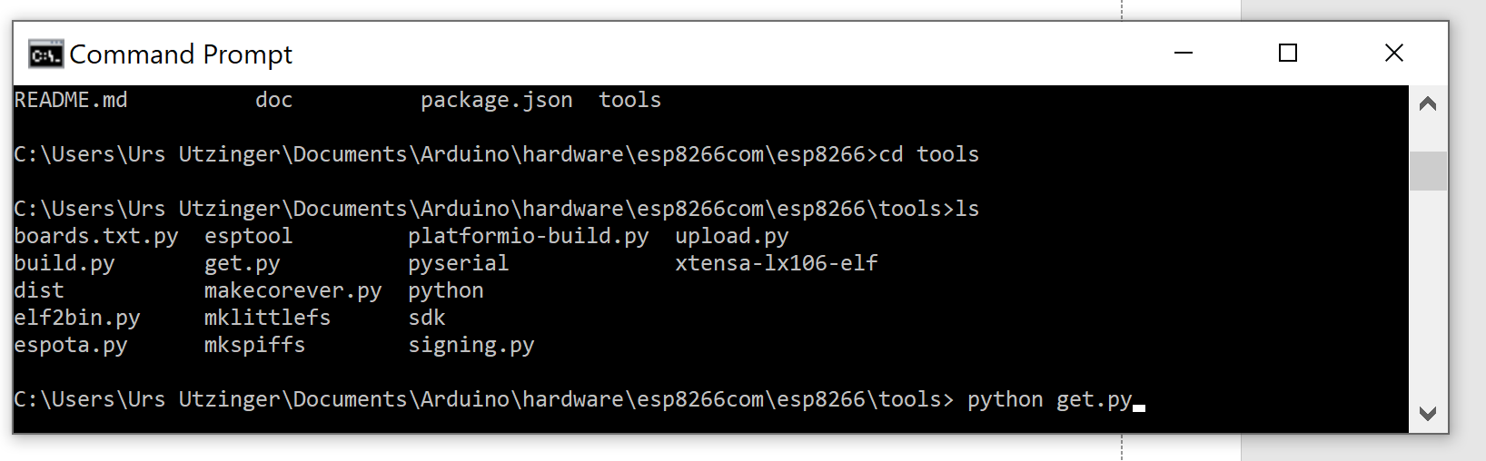
Finish Installation
Open Windows CMD shell
Execute:
“cd esp8266/tools”
“python get.py”

Slide 36
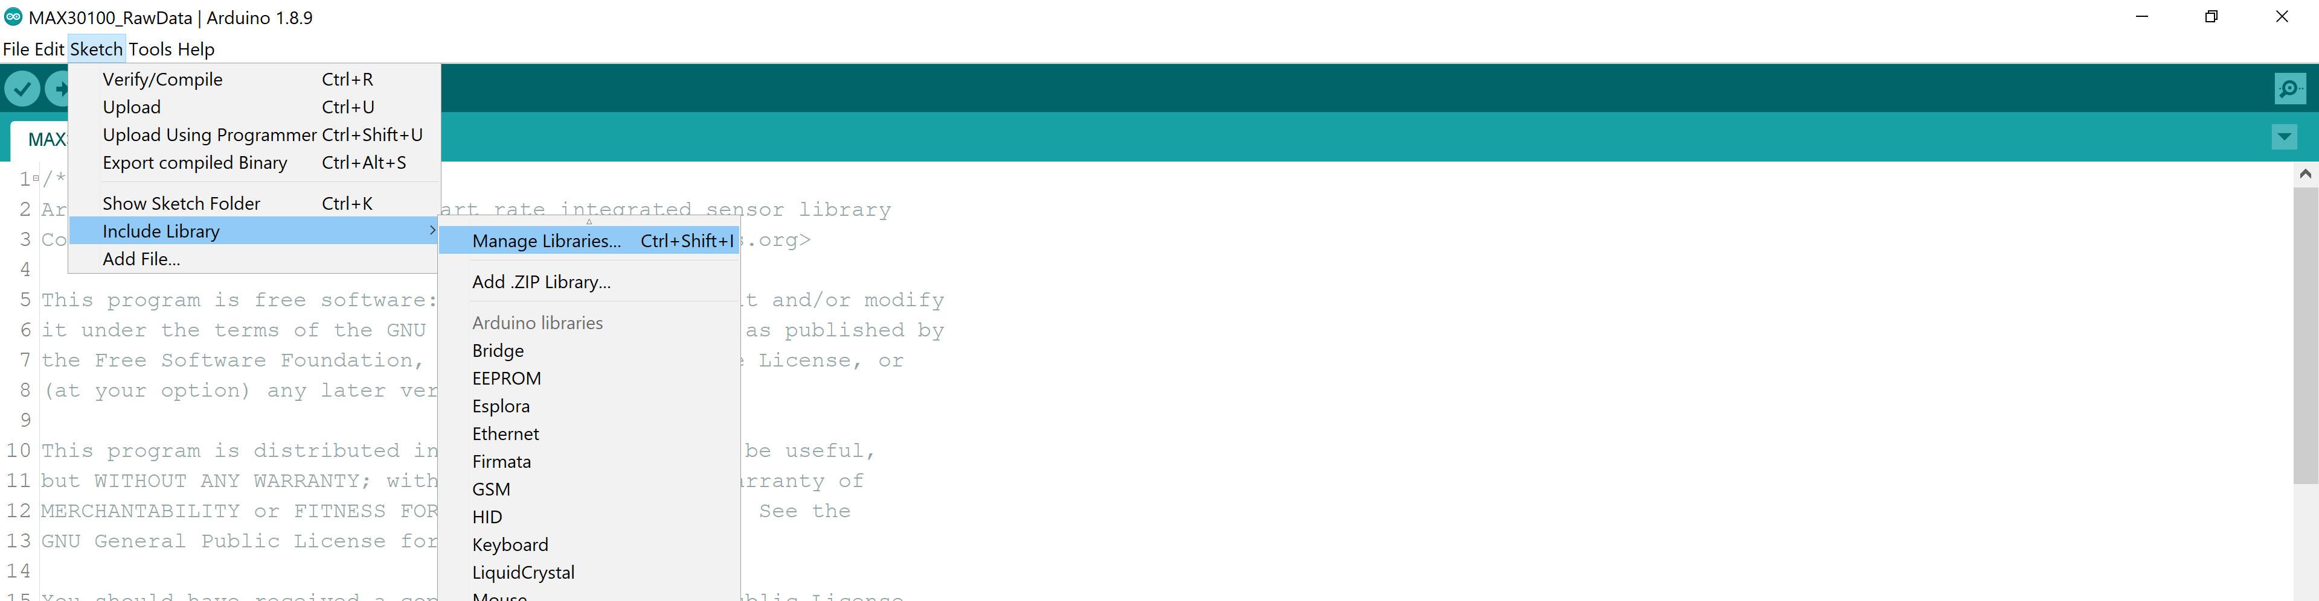
Installing Libraries in Arduino for Display
We need:
Adafruit GFX Library
Adafruit SSD1306
CircularBuffer by AgileWare

Slide 37
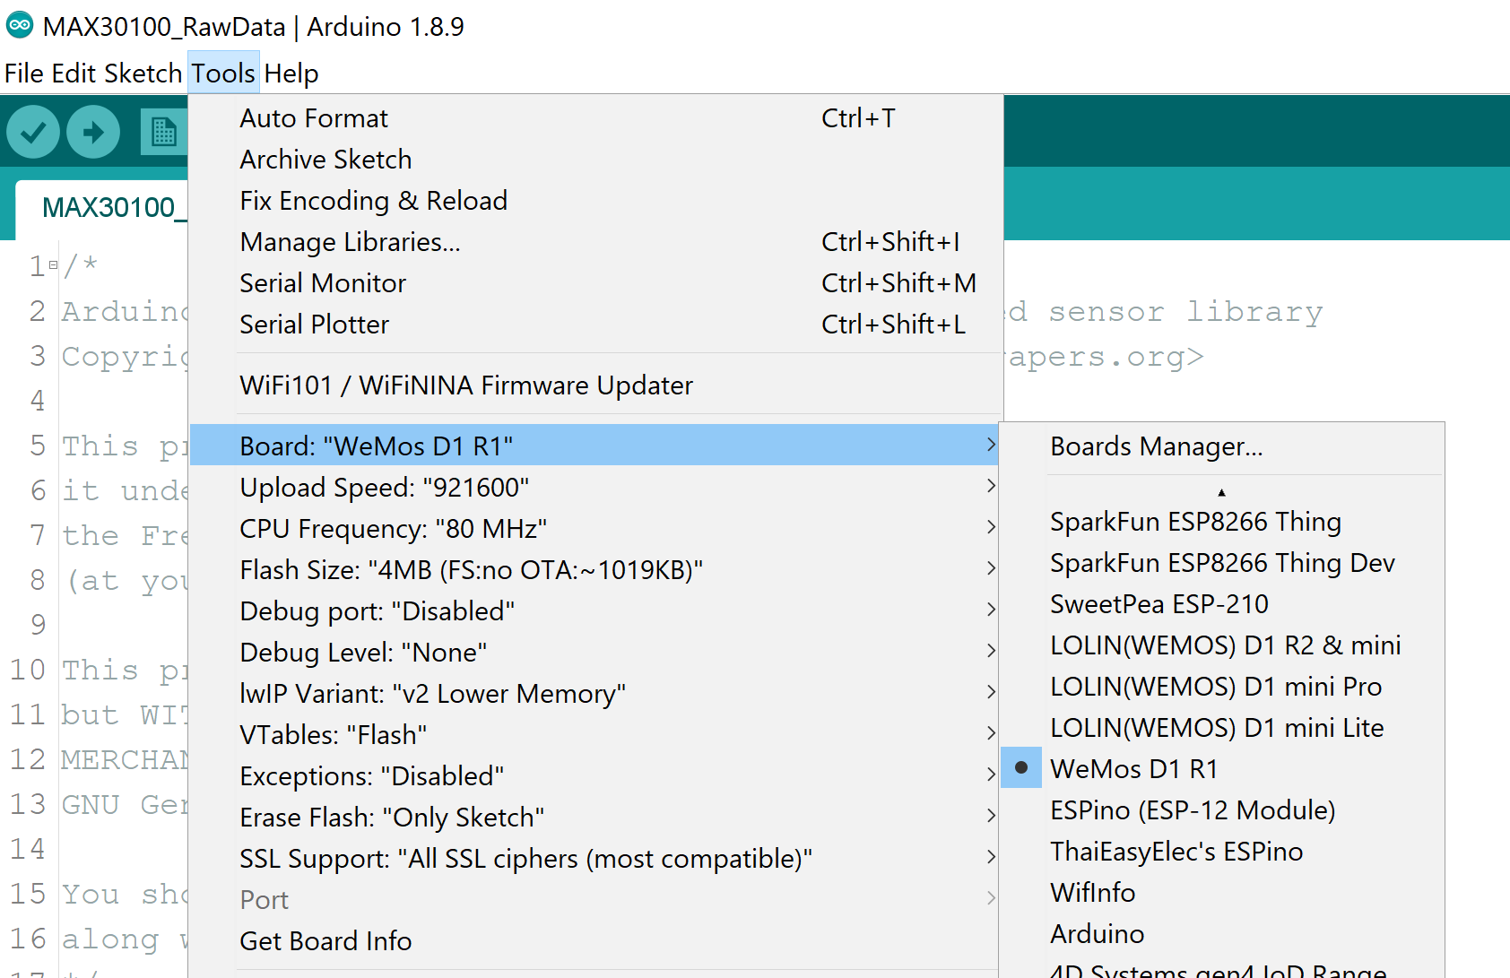
Configure Arduino for ESP8233
1) Select ESP8233 board
2) select correct port once ESP module is attached with USB cable

Slide 38
Are the devices connected?
https://github.com/RobTillaart/Arduino/tree/master/sketches/MultiSpeedI2CScanner
Download and save to Documents/Arduino
Compile and Execute and the program should find two I2C devices, one is the display, the other the sensor

Slide 39
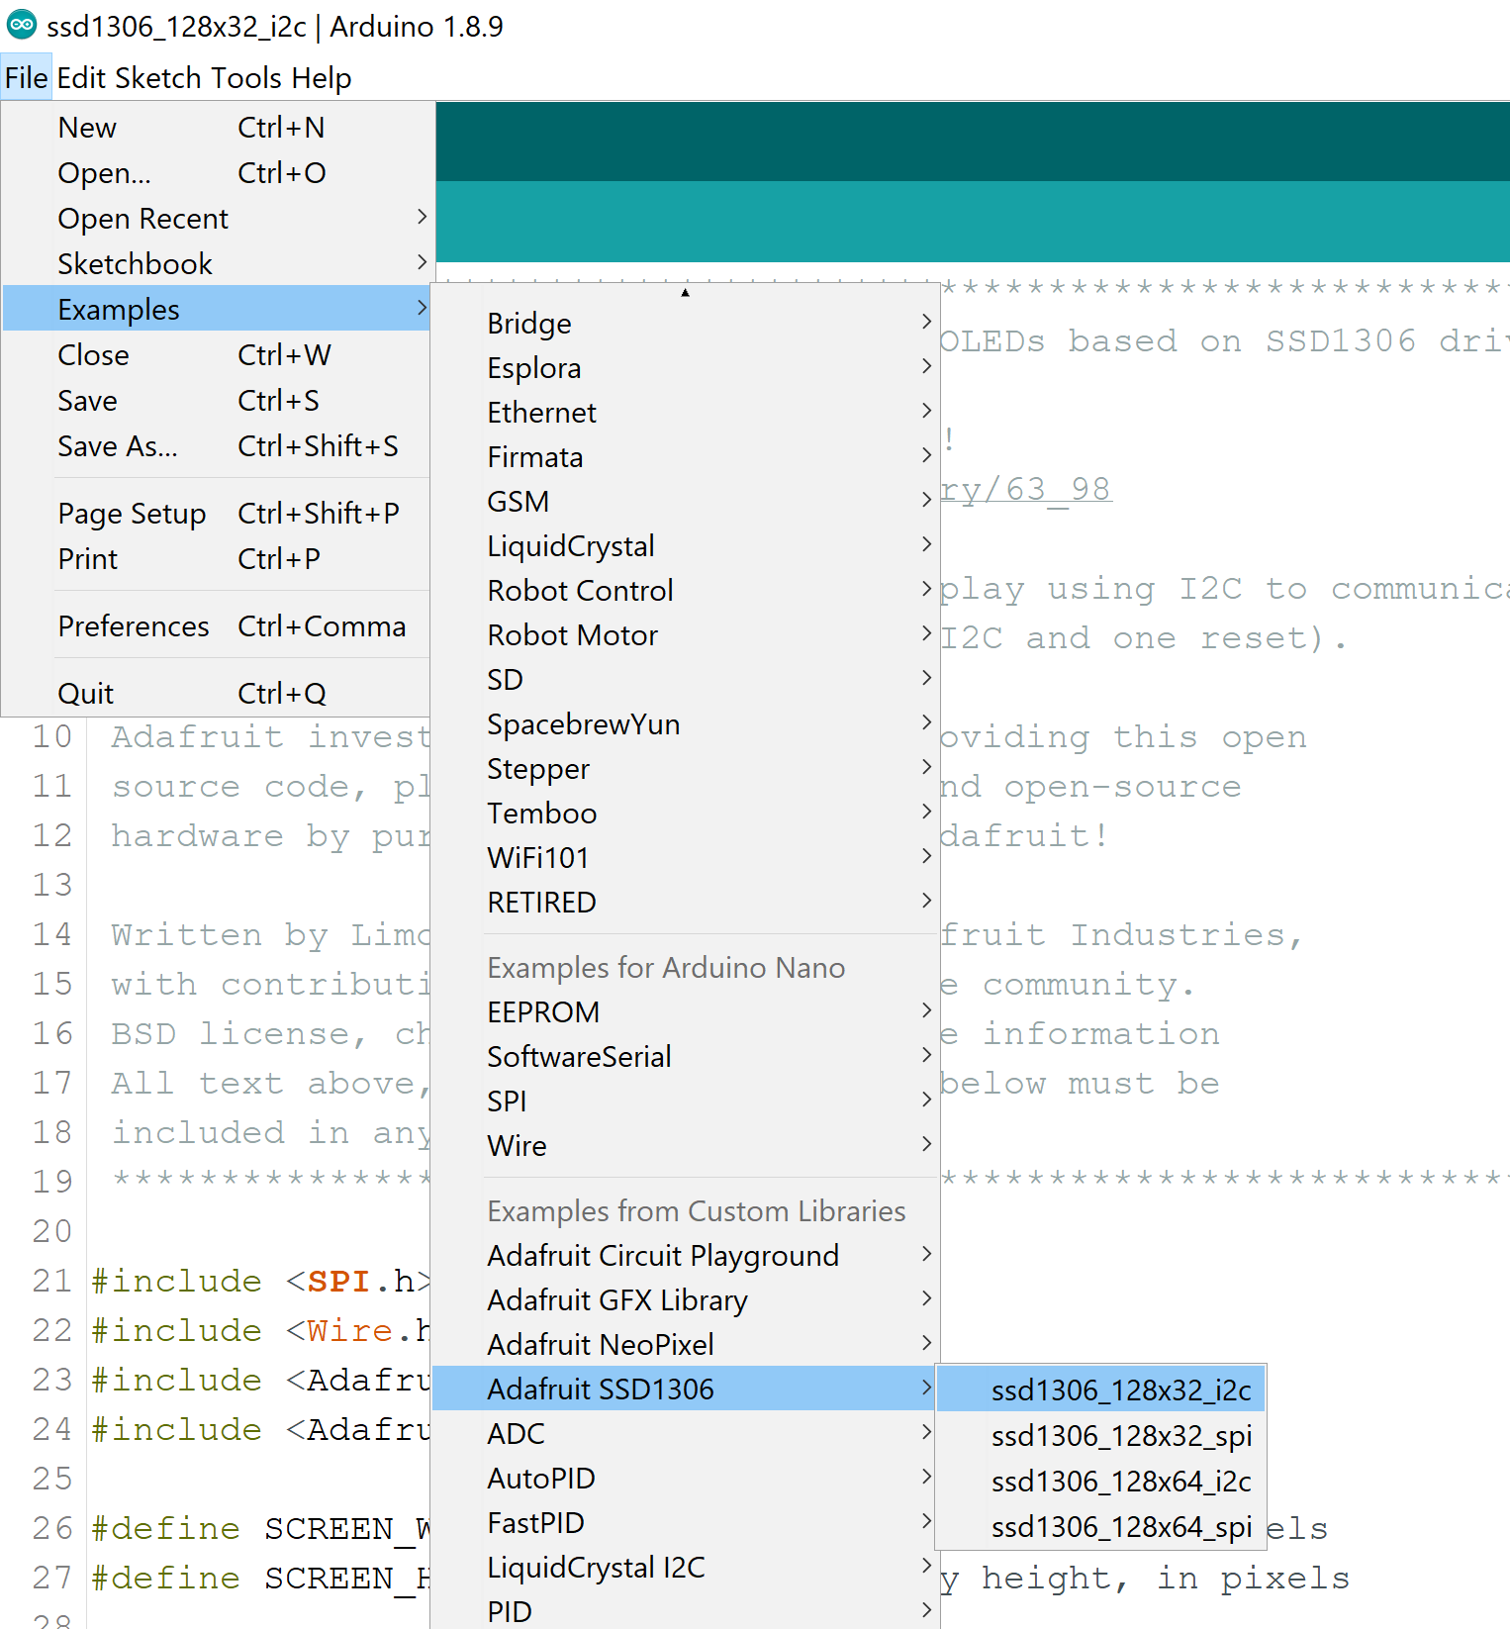
Check display
Change to code
serial baud rate of 115200
OLED rest pin is at -1

Slide 40
Check WiFi & Web Server
In Examples open EPS8266WebServer/AdvancedWebserver
Change code
#ifndef STASSID
#define STASSID "DATA"
#define STAPSK ""
#endif
AND
if (password != ""){
WiFi.begin(ssid, password);
} else {
WiFi.begin(ssid, NULL);
}

Slide 41
Does it work?
Start the program on the ESP8266
On your phone
Connect to DATA network
Turn off mobile data
Point your webbrowser to the ip address indicated on the serial monitor of the ESP8266

Slide 42
Now get my example code
https://github.com/uutzinger/sea

Slide 46
Software
Arduino IDE
Processing Graphical Display
Github

Slide 47
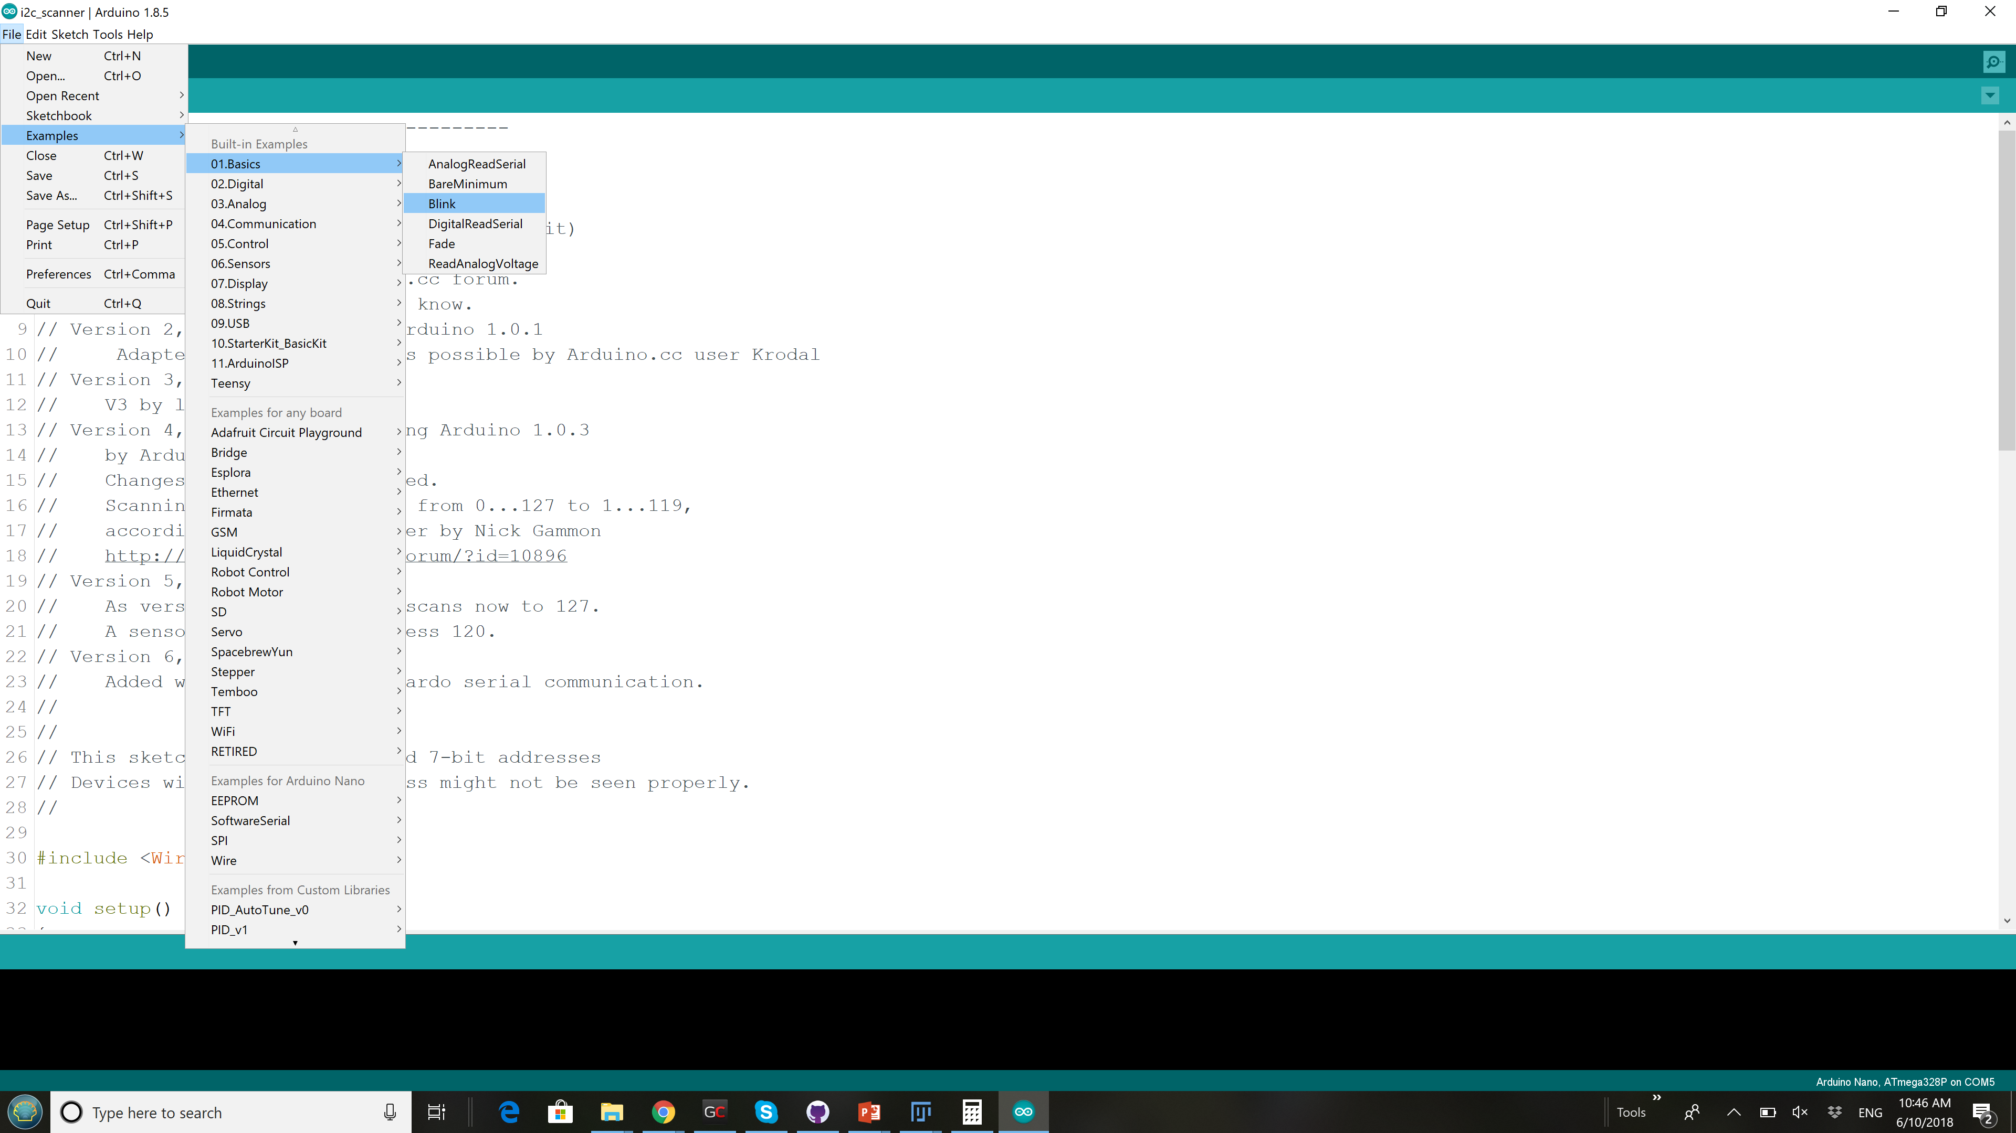
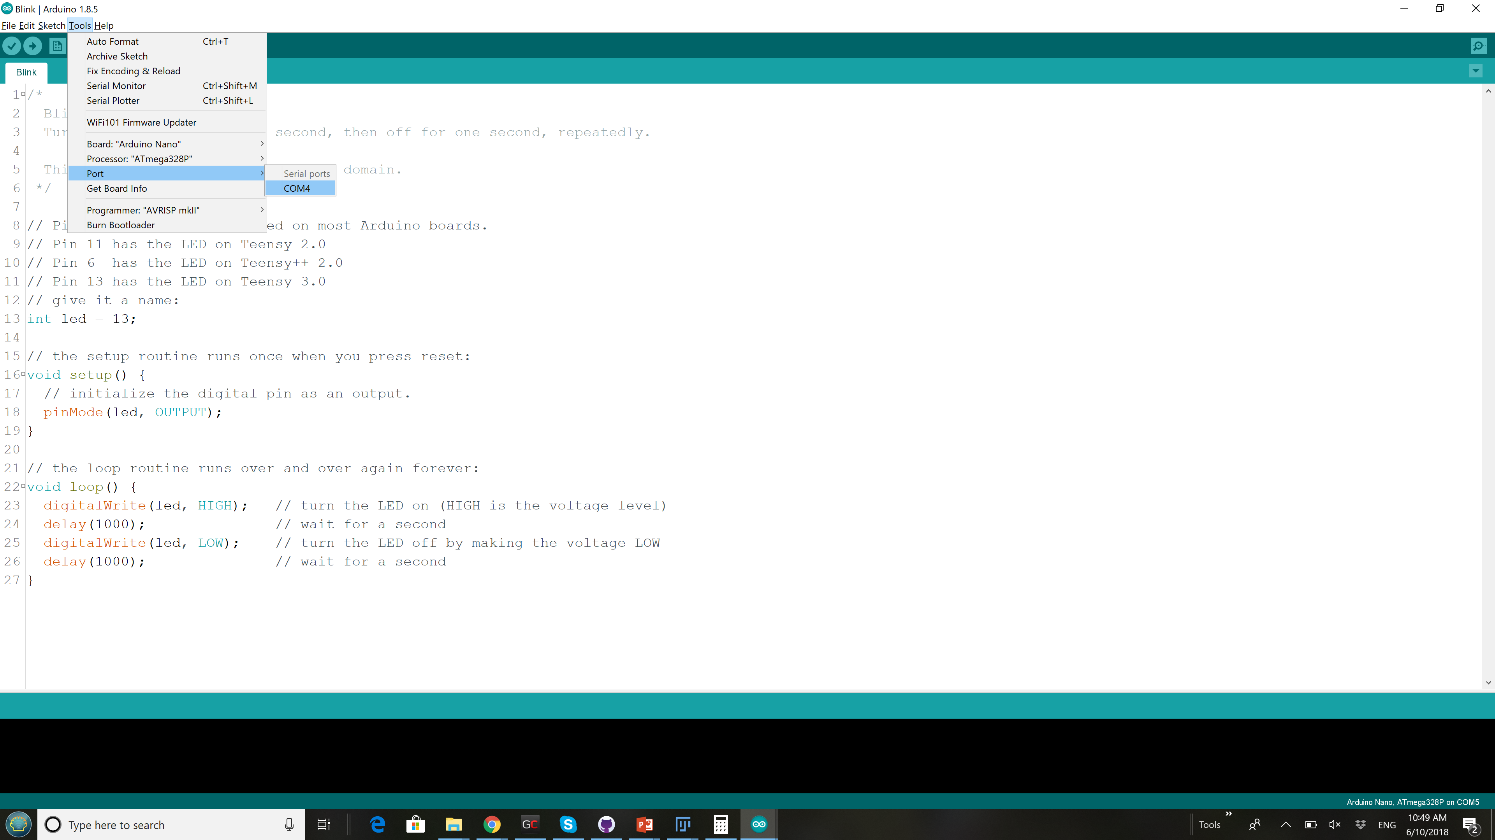
Arduino IDE
Find Arduino Integrated Development Environment on your Desktop Computer
Open the Blink Example
Connect the Arduino Nano to Computer
Select Proper Microcontroller and Port

Slide 48
MAX3010x Driver and Example
Github
Dowload Dirver and Example Program: https://github.com/uutzinger/MAX30105
There is Clone/Download button. Do not use desktop app.
Place the downloaded archive on desktop and unpack it.
Rename the folder to MAX30105
Load MAX30105 into Arduino and upload to microcontroller

Slide 49
Check Communication with Arduino Nano
Open Tools / Serial Monitor
Set speed to 115200 at bottom right.
You should see lines of numbers on the screen

Slide 50
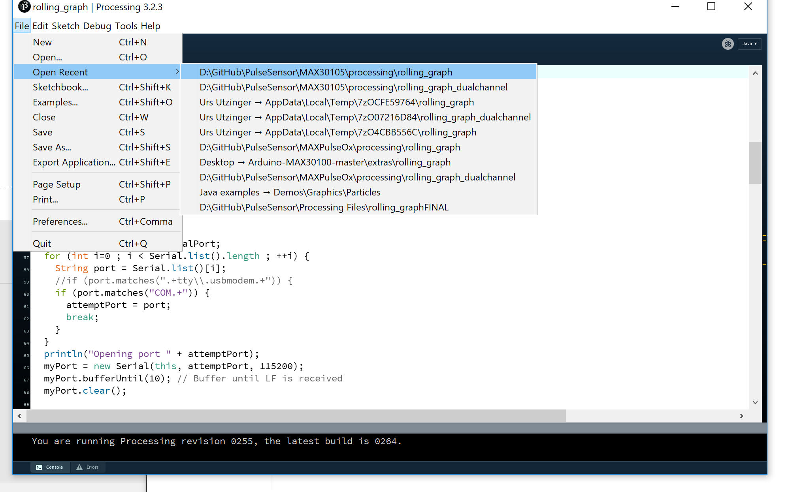
Processing

Slide 51
Open the rolling graph application by double clicking on it in processing folder of MAX30105
A new program starts
Make sure that the serial port named in the program matches the one you used for programming the Arduino nano e.g. COM3 or COM4 or COM5
If the program shows an error when opening the COM port

Slide 52
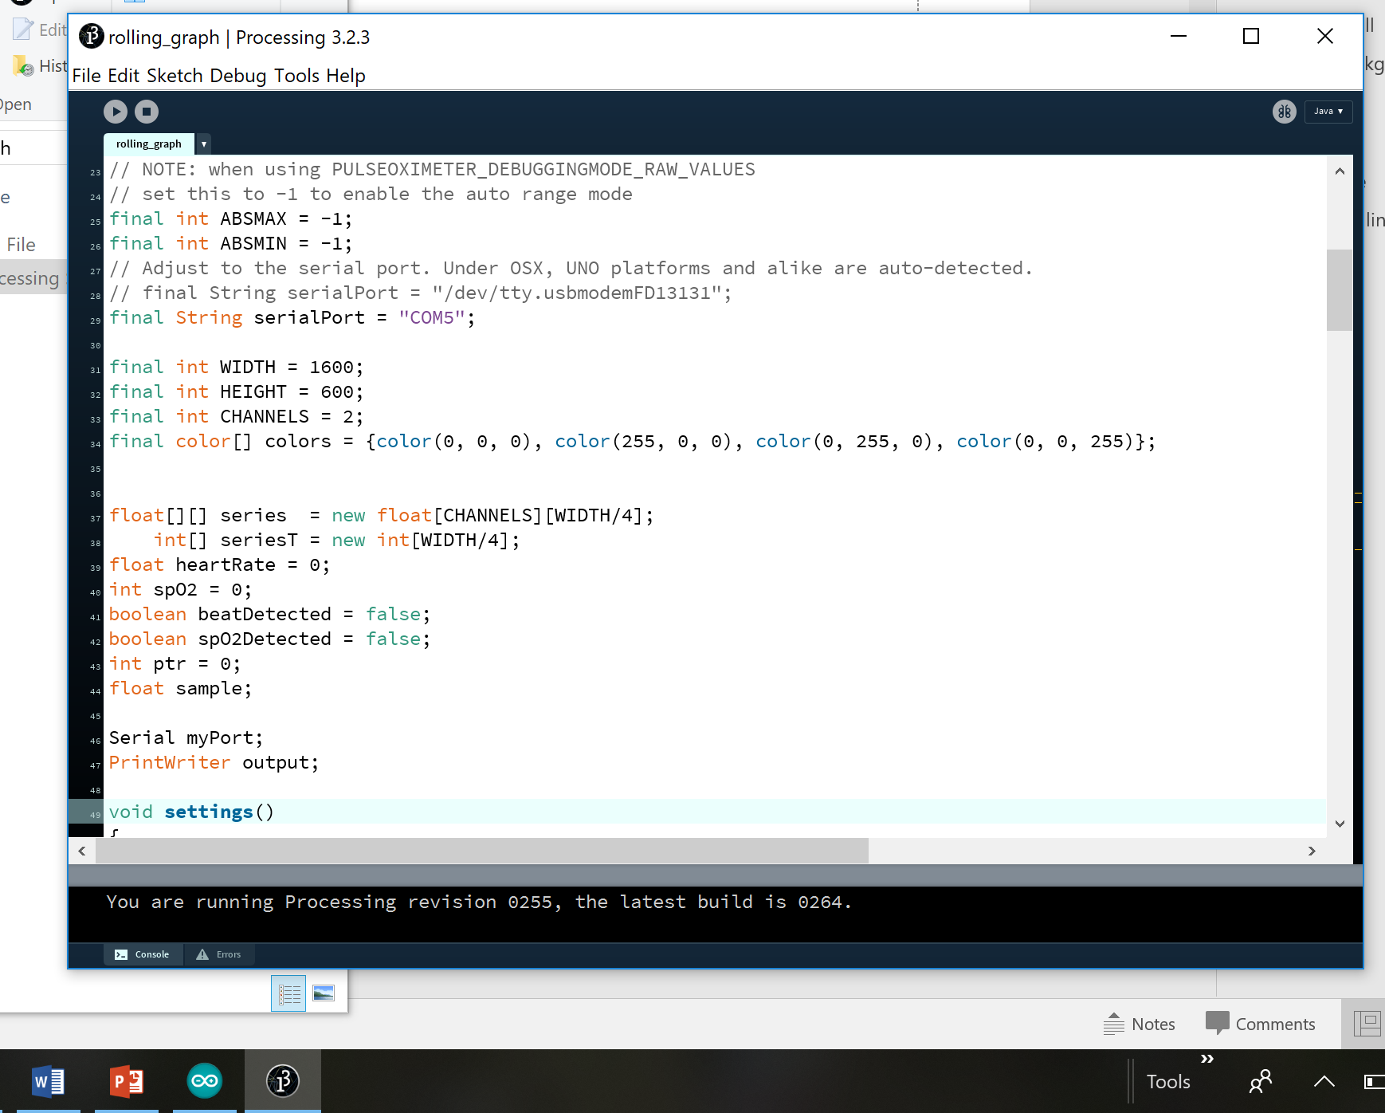

Slide 53
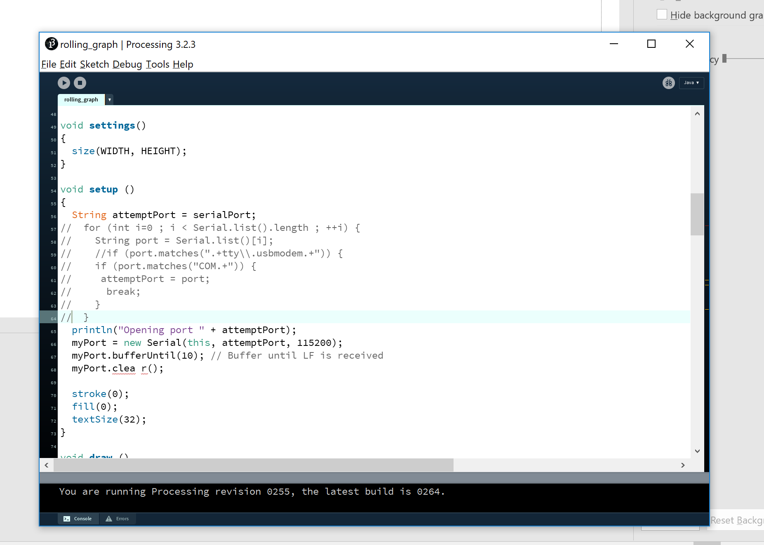

Slide 54
What is in an Arduino Program (C++)
#define
#include
global variables
setup
loop
subroutines
control statements:
for loop
if statement

Slide 55
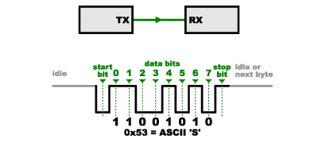
Serial Communication

Slide 56
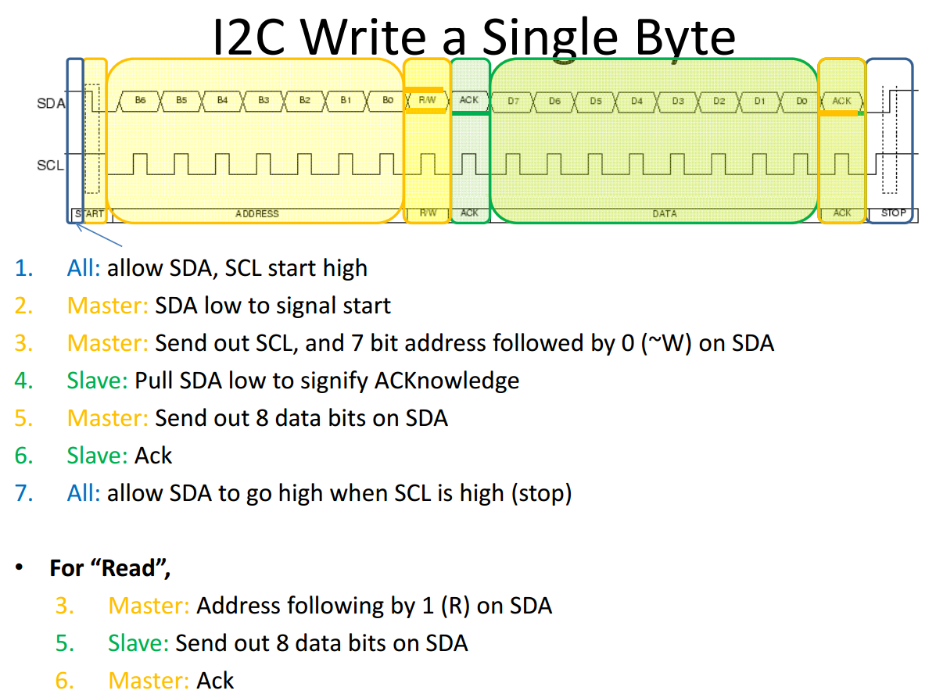

Slide 57
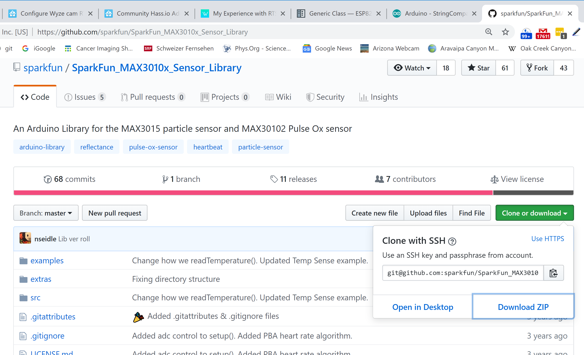
Check MAX3010x
Download Sparkfun MAX3010x library
Extract to Documents/Arduino
Open FIFO_Readings.ino in examples folder
Change baud rate to 115200
Change sample average to 8
Change sampleRate to 800
Run it

